Slide 1
Smart Mirror
Matthew Apple
Kyle Bobak
Shaya Wolf

Slide 2
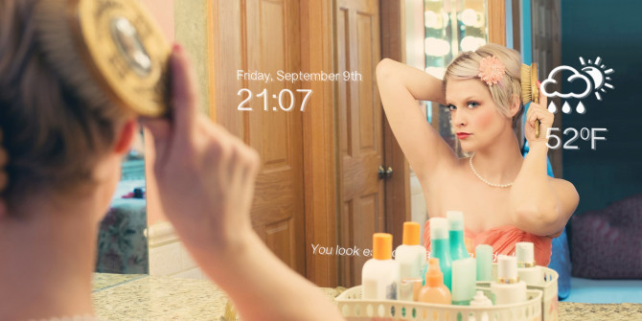
http://cdn.makeuseof.com/wp-content/uploads/2016/09/smart-mirror-670x335.jpg?369515

Slide 3
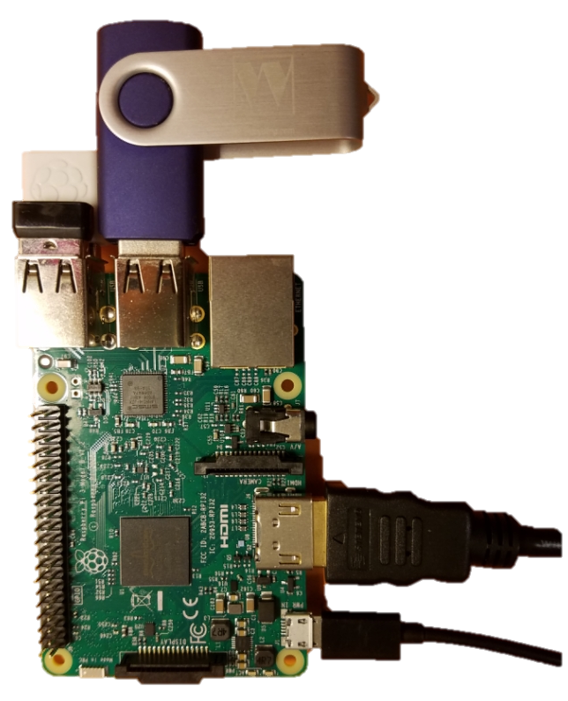
Introductions
Wi-Fi Dongle
Our Team
Our Project
Our Presentation
Motivation
Functionality
Implementations
Crazy Cheap Jump Drive
Wireless Mouse
(for testing)
HDMI
(to screen)
Power (Micro USB)
Notes:
Our Team
-- Introduce selves
Our Project
-- A smart mirror is a mirror that displays information.
-- Describe our mirror: A cabinet-style mirror, made from recycled barnwood and two-way mirrored acrylic on top of a TV screen. The Mirror is run on a raspberry pi, a small computer that uses the TV as a monitor.
-- Describe raspberry pi by picture and budget (< $100)
Our Presentation
-- Preview Points

Slide 4
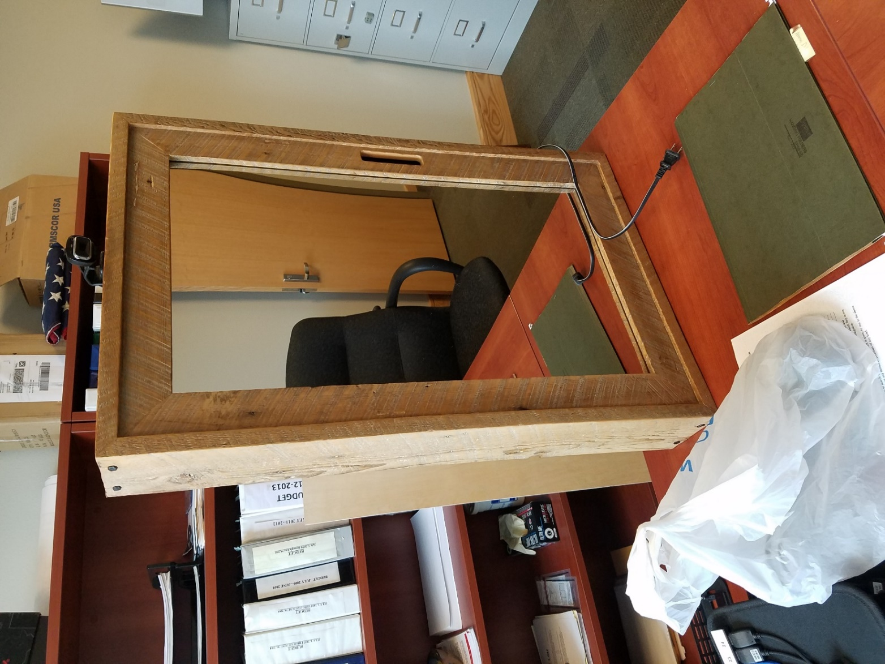
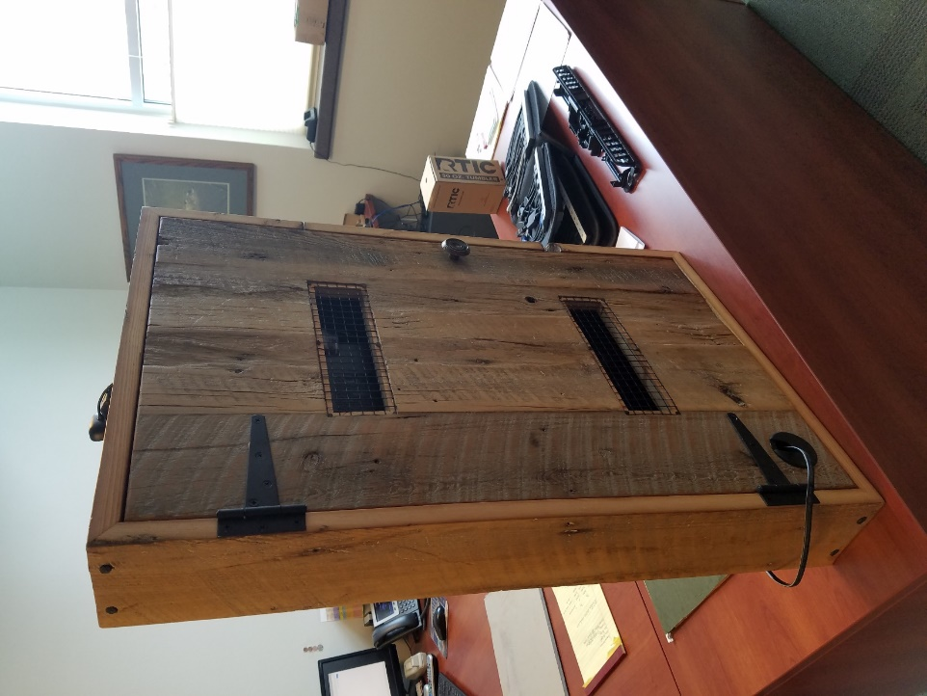

Motivation
Why build a smart mirror?
Our Goals
Smart Mirror
Notes:
Why build a smart mirror?
-- Want to pick something being done in the industry now and do that to our skill level
-- Internet of things = prevalent
Our Goals
-- Build a cabinet to hold the mirror
-- Build software from the ground up (lots of help from professor Ward)
-- An intuitive design

Slide 5
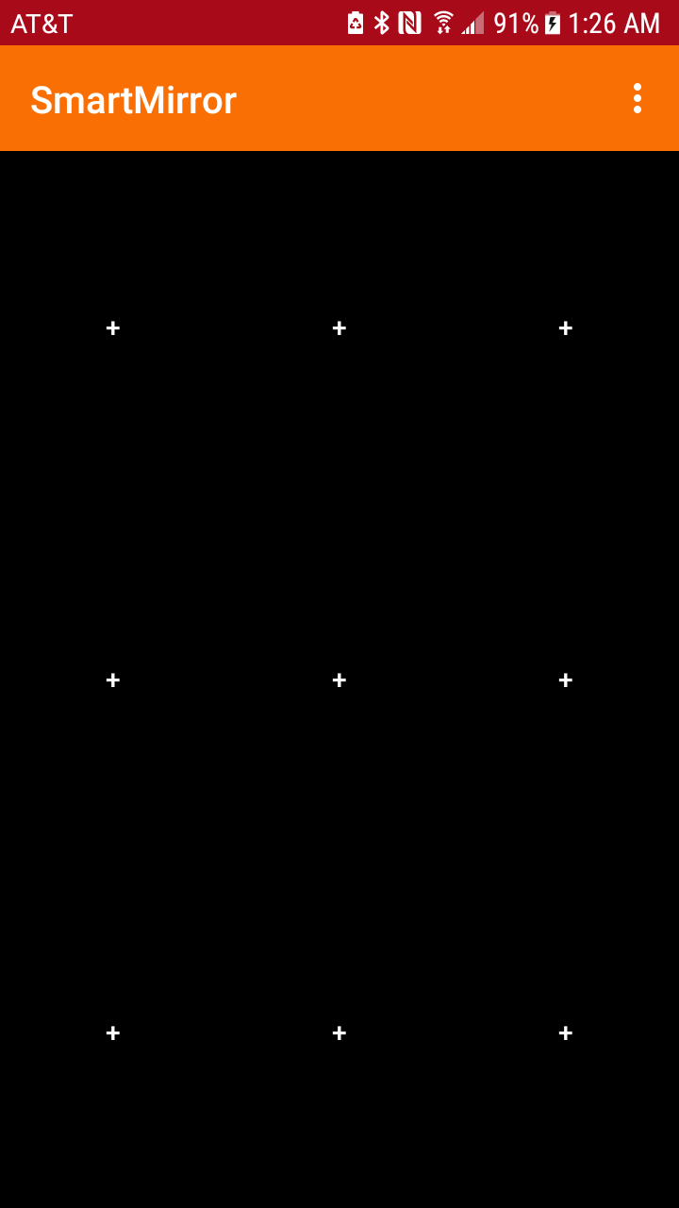
Functionality
What does it do?
Our Work
Required Skills
Notes:
What does it do
-- Explain basic layout
-- 9 Panel Display
----- If you tap -> it brings up options to set that panel
----- If you long hold -> it brings up the options window to edit the current panel
-- Intuitive Phone App
Our Work
Required Skills

Slide 6
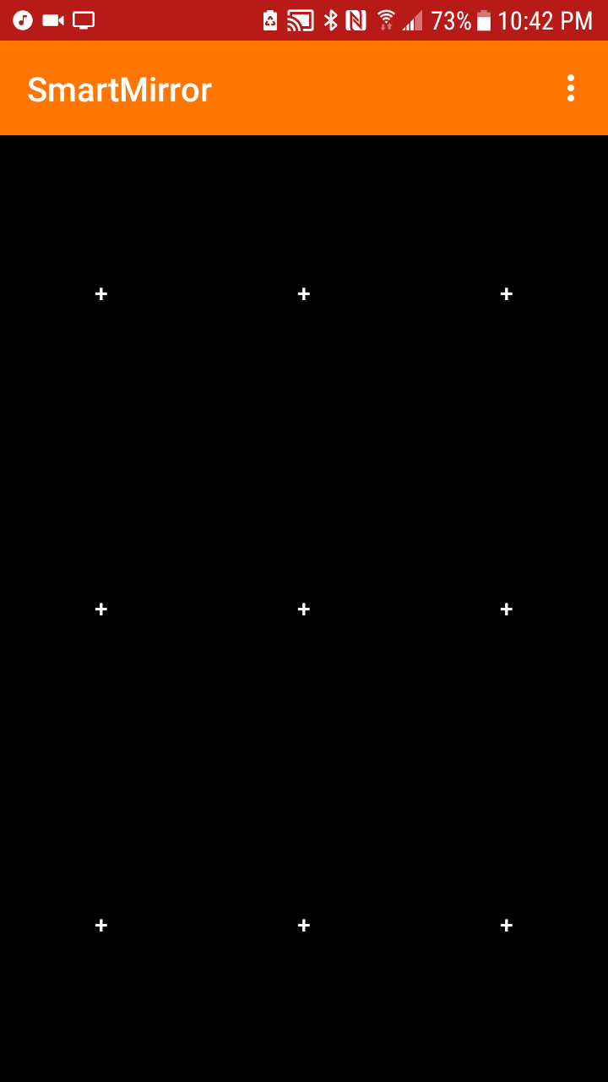
Functionality
What does it do? → Panel Options
Options Include:
Clock
Weather
Reminder
Alarm

Slide 7
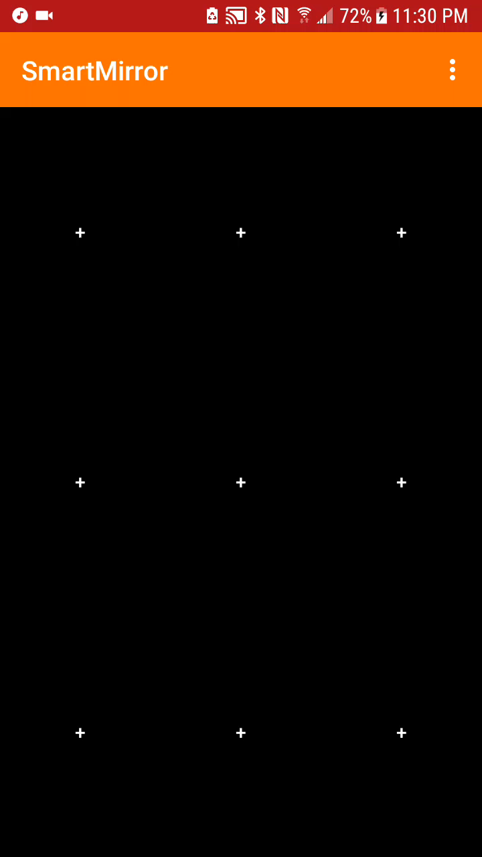
Functionality
What does it do? → Color Options
Change Colors
Background Color and Text Color
Saves Preferences
Clear Preferences
Notes:
Color Options Demo
Change Colors
-- Preference changes save on close for the app
-- Sync button in the future

Slide 8
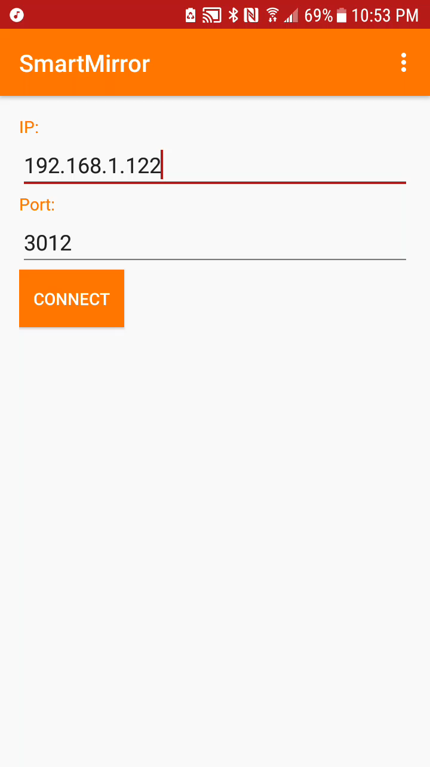
Functionality
What does it do? → Networking
Notes:
Networking Demo

Slide 9
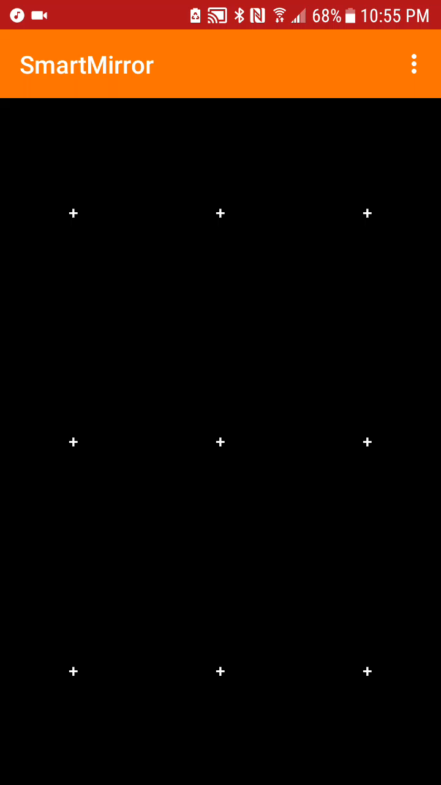
Functionality
What does it do? → Menu Options
Edit Network
Stretch Goals / Future Features
Sleep Timer
Hand Gestures
Voice Control
Power On/Off
Notes:
Menu Options Demo

Slide 10
Functionality
What does it do?
Our Work
Design Decisions
Build Mirror
Code Phone App
Code for Mirror
Networking Code
Add Widgets
Put it all Together
Planning
Gather Materials
Coding
Notes:
-- Timeline
Planning – Hardware and Software design decisions and gathering materials
Build Mirror – Wanted to give it that Wyoming feel (rustic, western, but clean looking)
Coding – LOC = 7,800
Putting it all together – Lots of random issues but nothing too big to handle

Slide 11



Functionality
hat does it do?
Required Skills
https://www.mysql.com/common/logos/logo-mysql-170x115.png
https://www.raspberrypi.org/wp-content/uploads/2015/08/raspberry-pi-logo.png
https://1.bp.blogspot.com/-PwaAONmMm78/V-ASbVPG39I/AAAAAAAADZY/boHNhTW5V4Y45qzx6gIweePgoO2VkIhfQCLcB/s1600/image04.png
Notes:
Required Skills
-- Android programming (Java/XML) (13 Java Classes/Files and 30 XML Files)
-- MySQL and Databases
-- Networking
-- Raspberry Pi (Installing the Operating System)
-- Building the mirror (Carpentry)
-- Minimal Debugging

Slide 12
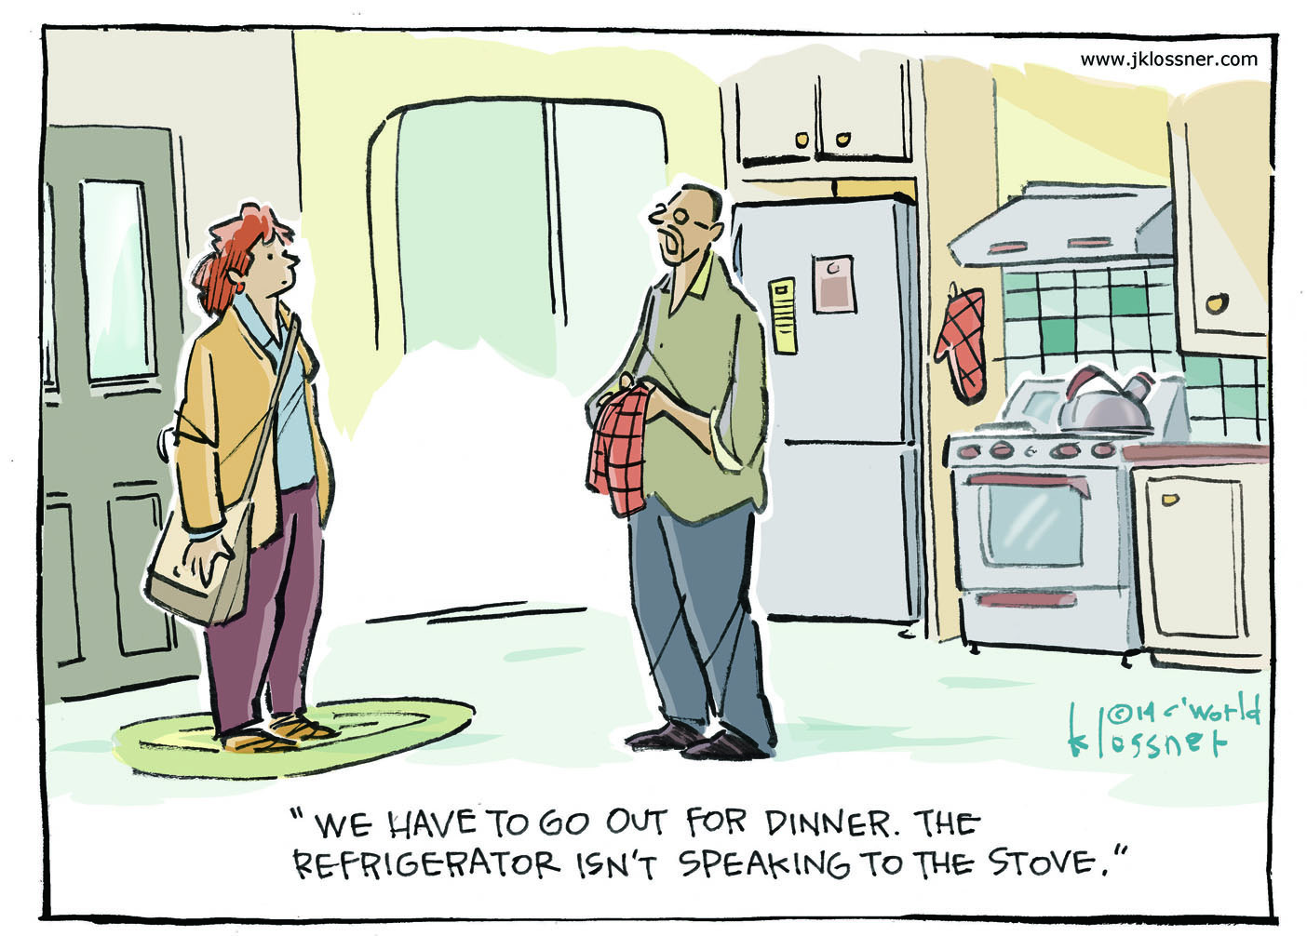
Implementations
Applications
Future Goals
Demonstrations
http://core0.staticworld.net/images/article/2014/12/05_klossnerj_internetofthings_03-24-2014-100535431-orig.jpg
Notes:
Applications
-- Internet of Things → Raises a ton of security questions
Future Goals
-- Voice Control
-- Hand Gestures
-- Children’s Games (tooth brushing or getting ready in the morning)
-- Music
-- Previewing a hair cut
Demonstrations
--

Slide 13
Smart Mirror
“The Internet will disappear. There will be so many IP addresses, so many devices, sensors, things that you are wearing, things that you are interacting with, that you won't even sense it. It will be part of your presence all the time."
— Eric Schmidt, Google chairman

